Slide 1
Information Technology FIT3143 Parallel Computing Semester 2 2026
Lab #1 (Week 3)
POSIX Threads & OpenMP

Slide 2
Overview - Parallel computing on shared memory
POSIX Threads - Part II [45 min]
Semaphores
Thread signaling using condition variables
OpenMP [1 hr]
Basic architecture
Parallelism with #pragma construct
Critical section and atomicity
Additional constructs (reduction, sections, etc.)

Slide 3
POSIX* Thread or Pthread

Slide 4
Semaphores
Semaphore, includes:
Counter,
Waiting list of process, and
Supports two different operations i.e., wait and signal.
Often known as: a counter with a mutex and a waiting queue.
Types:
Counting semaphores and binary semaphores.
Uses:
Synchronization tool to deal with critical-section problem.
Provides simple abstraction for controlling access to a common resource in programming environment.

Slide 5
Semaphores
How semaphore works:
A counter that tracks available resources:
If the counter > 0:
A process can use the resource, and the counter decreases.
When the process finishes, it increases the counter.
If the counter = 0:
Other processes have to wait.

Slide 6
Semaphores
1 #include <stdio.h>
2 #include <pthread.h>
3 #include <semaphore.h>
4 #include <unistd.h>
5
6 sem_t mutex;
7
8 void* thread(void* arg)
9 {
10 //wait
11 sem_wait(&mutex);
12 printf("\nEntered..\n");
13
14 //critical section
15 sleep(8);
16
17 //signal
18 printf("\nJust Exiting...\n");
19 sem_post(&mutex);
20 }
23 int main()
24 {
25 sem_init(&mutex, 0, 2);
26 pthread_t t1,t2,t3;
27 pthread_create(&t1,NULL,thread,NULL);
28 sleep(2);
29 pthread_create(&t2,NULL,thread,NULL);
30 sleep(2);
31 pthread_create(&t3,NULL,thread,NULL);
32 pthread_join(t1,NULL);
33 pthread_join(t2,NULL);
34 pthread_join(t3,NULL);
35
36 sem_destroy(&mutex);
37 return 0;
38 }
[tmak@m3-login1 test-FIT3143]$ ./Semaphore
Entered..
Entered..
Just Exiting...
Entered..
Just Exiting...
Just Exiting...
https://www.geeksforgeeks.org/c/use-posix-semaphores-c/

Slide 7
Condition Variables
Condition variables
Synchronization primitives allowing threads to wait for a specific condition before continuing execution.
Commonly used in multithreaded programs to coordinate communication between threads and avoid unnecessary busy waiting.
Used together with mutexes to safely synchronize access to shared resources.
Idea: Allows one thread to wait while another thread signals that a task or resource is ready.
Application: Producer-consumer, sender-receiver, and task scheduling scenarios.

Slide 8
Semaphores vs. Condition Variables
Semaphores and Condition Variables share the same core operations (wait() and signal())to provide mutual exclusion. However, they differ in how they manage waiting threads:
Semaphores are strictly conditioned on an internal semaphore count (blocking when zero, proceeding when non-zero).
Condition Variables are associated with an arbitrary logical condition defined by the programmer.
Threads sleep on a condition variable until signaled. Once awakened, the thread checks the custom condition: if met, it proceeds; otherwise, it is directed back to waiting.

Slide 9
Common Problems with Condition Variables
Problem 1: Lost Signals
Condition variables have no memory. If a signal is sent when no thread is waiting, the signal is permanently "lost."
A thread that blindly waits without checking the condition first may deadlock, waiting forever for a signal that already happened.
Always test the condition before deciding to wait.

Slide 10
Common Problems with Condition Variables
Problem 2: Spurious Wakeups
To maximize performance on multiprocessor systems, threads can occasionally wake up without actually receiving a signal.
Always re-test the condition immediately after waking up. If it was a spurious wakeup, the thread should go right back to sleeping.

Slide 11
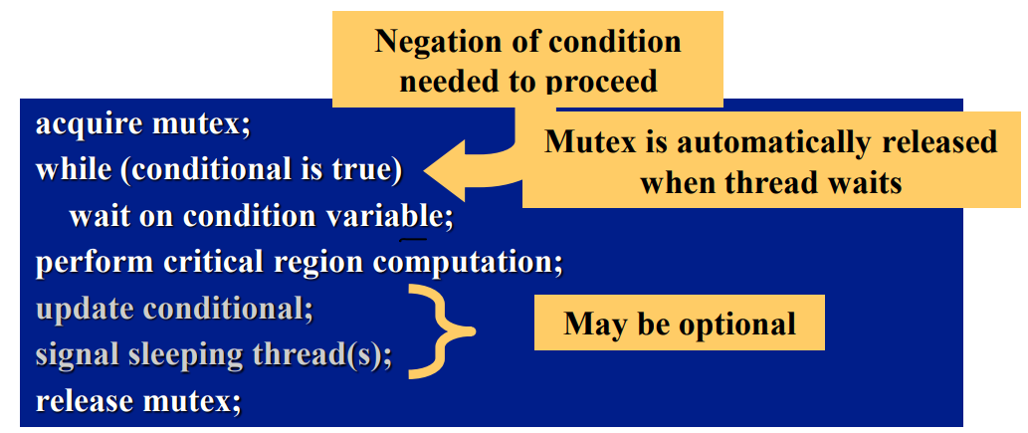
Condition Variable and Mutex
Mutex is associated with condition variable
Protects evaluation of the conditional expression
Prevents race condition between signaling thread and threads waiting on condition variable
Avoid problems with lost and spurious signals

Slide 12
Condition Variables
pthread_cond_init, pthread_cond_destroy
initialize/destroy condition variable
pthread_cond_wait
thread goes to sleep until signal of condition variable
pthread_cond_signal
signal release of condition variable
pthread_cond_broadcast
broadcast release of condition variable

Slide 13
Condition Variable Types
Data types used
pthread_cond_t
the condition variable
pthread_condattr_t
condition variable attributes
Before use, condition variable (and mutex) must be initialized
Pthreads introduces pthread_cond_t to allow threads to pause execution until a specific condition is met.
A condition variable must be initialized before it can be used.
Condition variables stored in shared memory can also be shared across different processes.

Slide 14
pthread_cond_init
int pthread_cond_init( cond, attr );
pthread_cond_t *cond
condition variable to be initialized
const pthread_condattr_t *attr
attributes to be given to condition variable
ENOMEM - insufficient memory for condition variable
EAGAIN - insufficient resources (other than memory)
EBUSY - condition variable already intialized
EINVAL - attr is invalid
Can also use the static, default initializer: PTHREAD_COND_INITIALIZER
pthread_cond_t cond1 = PTHREAD_COND_INITIALIZER;
which uses default attributes

Slide 15
pthread_cond_wait
int pthread_cond_wait( cond, mutex );
pthread_cond_t *cond
condition variable to wait on
pthread_mutex_t *mutex
mutex to be unlocked
Thread put to “sleep” waiting for signal on cond
Mutex is unlocked
Allows other threads to acquire lock
When signal arrives, mutex will be reacquired before pthread_cond_wait returns
EINVAL - cond or mutex is invalid
EINVAL - different mutex for concurrent waits
EINVAL - calling thread does not own mutex

Slide 16
pthread_cond_signal
Signal condition variable, wake one waiting thread
If no threads waiting, no action taken
Signal is not saved for future threads
Signaling thread need not have mutex
May be more efficient
Problem may occur if thread priorities used
int pthread_cond_signal( cond );
pthread_cond_t *cond
condition variable to be signaled
EINVAL - cond is invalid

Slide 17
pthread_cond_broadcast
int pthread_cond_broadcast( cond );
pthread_cond_t *cond
condition variable to signal
Wake all threads waiting on condition variable
If no threads waiting, no action taken
Broadcast is not saved for future threads
Signaling thread need not have mutex
EINVAL - cond is invalid

Slide 18
Condition Variable and Mutex
1 #include <stdio.h>
2 #include <unistd.h>
3 #include <pthread.h>
4 #define NUM_THREADS 2
5
6 // Global variables
7 pthread_mutex_t g_Mutex = PTHREAD_MUTEX_INITIALIZER;
8 pthread_cond_t g_Cond = PTHREAD_COND_INITIALIZER;
9 int g_Val = 0;
10
11 // Thread 1 Callback Function
12 void *Thread1Func(void *pArg)
13 {
14 int* p = (int*)pArg;
15 int myNum = *p; // myNum = 0
16 pthread_mutex_lock(&g_Mutex);
17 printf("Thread Id: %d. Global value before updated by Thread2Func: %d\n", myNum, g_Val);
18 pthread_cond_wait(&g_Cond, &g_Mutex);
19 printf("Thread Id: %d. Global value after updated by Thread2Func: %d\n", myNum, g_Val);
20 g_Val += 1;
21 pthread_mutex_unlock(&g_Mutex);
22 return NULL;
23 }

Slide 19
[tmak@m3-login1 test-FIT3143]$ ./Cond
Thread Id: 0. Global value before updated by Thread2Func: 0
Thread Id: 1. Global value increased by 2!
Thread Id: 0. Global value after updated by Thread2Func: 2
Global Value: 3
Condition Variable and Mutex
25 // Thread 2 Callback Function
26 void *Thread2Func(void *pArg)
27 {
28 int* p = (int*)pArg;
29 int myNum = *p; // myNum = 1
30 pthread_mutex_lock(&g_Mutex);
31 g_Val += 2;
32 printf( "Thread Id: %d. Global value increased by 2!\n", myNum);
33 pthread_mutex_unlock(&g_Mutex);
34 pthread_cond_signal(&g_Cond);
35 return NULL;
36 }
38 // Main program
39 int main()
40 {
41 pthread_t hThread[NUM_THREADS]; // Stores the POSIX thread IDs
42 int threadNum[NUM_THREADS]; // Pass a unique thread ID
43 int i = 0;
44 // Initialize the mutex & condition variable
45 pthread_mutex_init(&g_Mutex, NULL);
46 pthread_cond_init(&g_Cond, NULL);
47 // Create both threads
48 threadNum[0] = 0;
49 pthread_create(&hThread[0], NULL, Thread1Func, &threadNum[0]);
50
51 sleep(2);
52
53 threadNum[1] = 1;
54 pthread_create(&hThread[1], NULL, Thread2Func, &threadNum[1]);
55
56 // Wait for all threads to finish
57 for(i = 0; i < NUM_THREADS; i++)
58 pthread_join(hThread[i], NULL);
59
60 printf( "Global Value: %d\n", g_Val);
61
62 // Clean up
63 pthread_cond_destroy(&g_Cond);
64 pthread_mutex_destroy(&g_Mutex);
65 return 0;
66 }
What would happen if Thread 2 runs before Thread 1?

Slide 20
Recap
Revisiting the Code from Week 2
PThreadBasic.c
PThread_Cond.c
Make sure you also studied
Cond.c

Slide 21
OpenMP

Slide 22
OpenMP
What Is OpenMP (or Open Multi-Processing)?
Compiler directives for multithreaded programming
Easy to create threaded Fortran and C/C++ codes
Supports data parallelism model
Incremental parallelism
Combines serial and parallel code in single source
Incremental parallelism is when you can modify only a portion of the code to test for better performance in parallel, then move on to another position in the code to test. Explicit threading models require a change to all parts of the code affected by the threading.
Serial code can be “retrieved” by not compiling with the OpenMP options turned on. Assuming that there were no drastic changes required to get the code into a state that could be parallelized.

Slide 23
OpenMP* Architecture
Fork-join model // execution model of thread in OpenMP parallel regions
Work-sharing constructs // for the pragmas and directives
Data environment constructs // for the pragmas and directives
Synchronization constructs // for the pragmas and directives
Extensive Application Program Interface (API) for finer control
// for the pragmas and directives

Slide 24
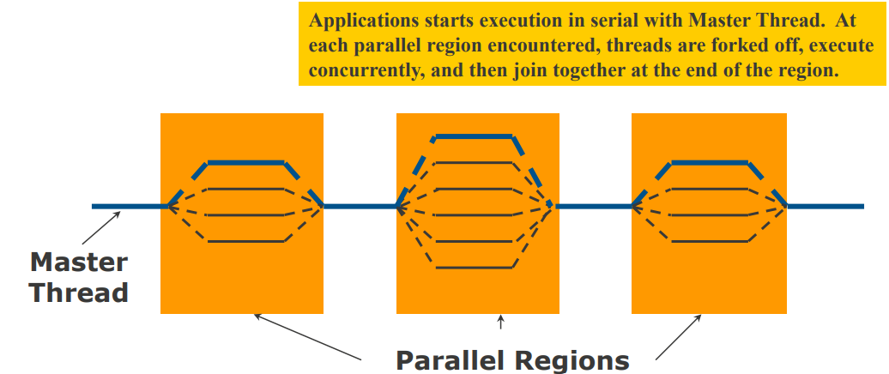
Programming Model
Fork-join parallelism:
Master thread spawns a team of threads as needed
Parallelism is added incrementally: the sequential program evolves into a parallel program

Slide 25
OpenMP* Pragma Syntax
Most constructs in OpenMP* are compiler directives or pragmas.
For C and C++, the pragmas take the form:
#pragam omp construct [clause [clause] … ]
Parallel Regions
Defines parallel region over structured block of code
Threads are spawned as execution enters the parallel region.
Threads implicitly synchronize (block) at the end of the region before the main thread continues.
Variables are shared by default across all threads, unless explicitly marked as private.
#pragma omp parallel
Thread
1
Thread
2
Thread
3

Slide 26
How Many Threads?
Set environment variable for number of threads:
set OMP_NUM_THREADS=4
There is no standard default for this variable
Many systems:
# of threads = # of processors
Intel compilers use this default
The order in which the system will try to determine the number threads is:
Default
Environment variable
API call
Each successive method (if present) will override the previous.

Slide 27
Example I
Serial Code
#include <stdio.h>
int main() {
int i;
printf("Hello World\n");
for(i=0;i<6;i++)
printf("Iter:%d\n",i);
printf("GoodBye World\n");
}
Parallel Code
#include <stdio.h>
#include <omp.h>
int main() {
#pragma omp parallel
{
int i;
printf("Hello World\n");
#pragma omp for
for(i=0;i<6;i++)
printf("Iter:%d\n",i);
}
printf("GoodBye World\n");
}

Slide 28
Work-sharing Construct - “for” work-sharing pragma
#pragma omp parallel
#pragma omp for
for (i=0; i<N; i++){
Do_Work(i);
}
Splits loop iterations across multiple threads.
Must be placed inside an existing parallel region.
Must precede the loop
#pragma omp parallel
#pragma omp for
#pragma omp parallel
#pragma omp for
for(i = 0; i < 12; i++)
c[i] = a[i] + b[i]
i = 0
i = 1
i = 2
i = 3
i = 0
i = 1
i = 2
i = 3
i = 0
i = 1
i = 2
i = 3
Implicit barrier
Threads are assigned an independent set of iterations and must wait at the end of work-sharing construct.

Slide 29
Work-sharing Construct - “for” work-sharing pragma
#pragma omp parallel
#pragma omp for
for(i = 0; i < 12; i++)
c[i] = a[i] + b[i]
#pragma omp parallel
#pragma omp for
i = 0
i = 1
i = 2
i = 3
i = 0
i = 1
i = 2
i = 3
i = 0
i = 1
i = 2
i = 3
Diagram shows a static division of iterations based on the number of threads. Note the implicit barrier at end of construct.
Why is there a barrier at the end of the work-sharing construct?
Implicit barrier

Slide 30
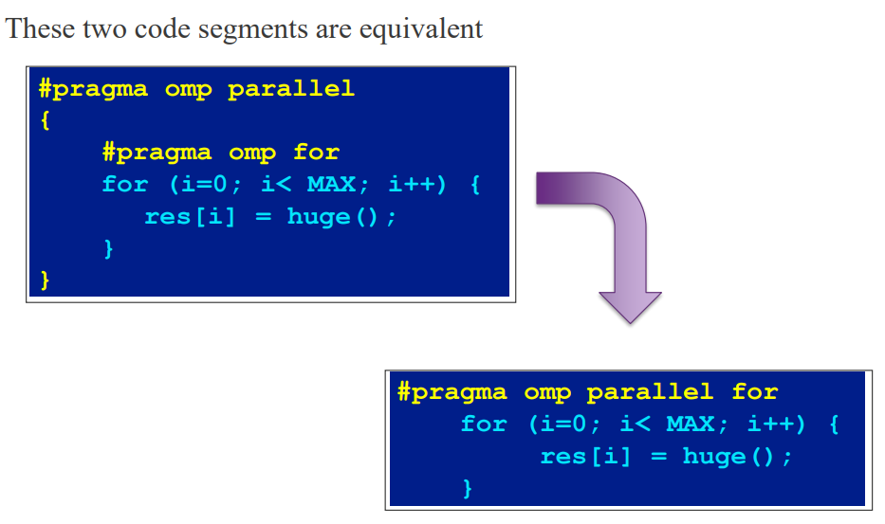
Combining pragmas

Slide 31
Data Environment
OpenMP uses a shared-memory programming model
Most variables are shared by default.
Global variables are shared among threads
C/C++: File scope variables, static
But not everything is shared,
Stack variables in functions called from parallel regions are PRIVATE
Automatic variables within a statement block are PRIVATE
Loop index variables are private (with exceptions)
C/C+: The first loop index variable in nested loops following a #pragma omp for

Slide 32
Data Scope Attributes
The default status can be modified with
Scoping attribute clauses
shared(varname, …)
default(shared | none)
private(varname, …)
All data clauses apply to parallel regions and work-sharing constructs except “shared”, which only applies to parallel regions.

Slide 33
The Private Clause
Reproduces the variable for each thread
Variables are un-initialized; C++ object is default constructed
Any value external to the parallel region is undefined
void* work(float* c, int N) {
float x, y;
int i;
#pragma omp parallel for private(x,y)
for(i=0; i<N; i++){
x = a[i];
y = b[i];
c[i] = x + y;
}
}
For-loop iteration variable is SHARED by default.
The private variables are uninitialized upon entering the parallel block, you must assign a value before reading them.
The private variables exist only within their scope and are destroyed at the end of the region.

Slide 34
Dot Product
float dot_prod(float* a, float* b, int N)
{
float sum = 0.0;
#pragma omp parallel for shared(sum)
for(int i=0; i<N; i++){
sum += a[i]*b[i];
}
return sum;
}
What’s wrong with the code?

Slide 35
Dot Product
Must protect access to shared, modifiable data
float dot_prod(float* a, float* b, int N)
{
float sum = 0.0;
#pragma omp parallel for shared(sum)
for(int i=0; i<N; i++){
#pragma omp critical
sum += a[i]*b[i];
}
return sum;
}
The “critical” pragma allows only one thread at a time to execute the update of sum.

Slide 36
OpenMP* Critical Construct
Defines a critical region on a structured block
#pragma omp critical [(lock_name)]
float R1, R2;
#pragma omp parallel
{ float A, B;
#pragma omp for for(int i=0; i<niters; i++){
B = big_job(i);
#pragma omp critical consum (B, &R1); //R1_lock
A = bigger_job(i);
#pragma omp critical consum (A, &R2); //R2_lock
} }
Threads wait their turn –at a time, only one calls consum() thereby protecting R1 and R2 from race conditions.
Naming the critical constructs is optional but may increase performance.

Slide 37
OpenMP* Reduction Clause
reduction(op : list)
The variables in “list” must be shared in the enclosing parallel region
Inside parallel or work-sharing construct:
A PRIVATE copy of each list variable is created and initialized depending on the “op”
These copies are updated locally by threads
At end of construct, local copies are combined through “op” into a single value and combined with the value in the original SHARED variable
#pragma omp parallel for reduction(+:sum)
for(i = 0; i < N; i++) {
sum += a[i] * b[i];
}

Slide 38
Schedule Clause
The schedule clause affects how loop iterations are mapped onto threads
Blocks of iterations of size “chunk” to threads
Round robin distribution
Threads grab “chunk” iterations
When done with iterations, thread request next set
Dynamic schedule starting with large block
Size of the blocks shrink; no smaller than “chunk”
schedule(static [,chunk])
schedule(dynamic [,chunk])
Default chunk size is 1
schedule(guided [,chunk])

Slide 39
Schedule Clause Example
#pragma omp parallel for schedule (static, 8)
for( int i = start; i <= end; i += 2 )
{
if ( TestForPrime(i) ) gPrimesFound++;
}
Set of iterations is divided up into chunks of size 8 and distributed to threads in round robin fashion.
Iterations are divided into chunks of 8
If start = 3, then first chunk is i={3,5,7,9,11,13,15,17}
Sample Code: omp_0.c

Slide 40
Parallel Sections
Independent sections of code can execute concurrently
OpenMP sections enable task parallelism by defining independent blocks of code to run concurrently.
The outer container is plural (sections), while each task uses singular (section). Code between section pragmas forms a task implicitly without needing extra curly braces.
Includes an implicit barrier at the end of the sections region.
Q: What if there are more/less threads than
tasks? How are tasks assigned to threads?
#pragma omp parallel sections
{
#pragma omp section
phase1();
#pragma omp section
phase2();
#pragma omp section
phase3();
}

Slide 41
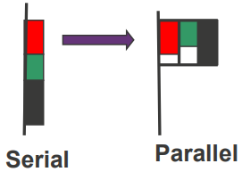
Parallel Sections
Independent sections of code can execute concurrently
#pragma omp parallel sections
{
#pragma omp section
phase1();
#pragma omp section
phase2();
#pragma omp section
phase3();
}
If tasks outnumber threads, threads process remaining tasks as they finish prior ones.
If threads outnumber tasks, extra threads wait at the implicit end barrier.
Section execution sequence is unpredictable, tasks must remain completely independent of one another.

Slide 42
Single Construct
Denotes block of code to be executed by only one thread
Thread chosen is implementation dependent
Implicit barrier at end
#pragma omp parallel
{
DoManyThings();
#pragma omp single
{
ExchangeBoundaries();
} // threads wait here for single
DoManyMoreThings();
}
Used when only one thread should execute a portion of code. This could be used when two parallel regions have very little serial code in between. Combine the two regions into a single region (less overhead for fork-join) and add the “single” construct for the serial portion.

Slide 43
Master Construct
Denotes block of code to be executed only by the master thread. No implicit barrier at end
#pragma omp parallel
{
DoManyThings();
#pragma omp master
{ // if not master skip to next statement
ExchangeBoundaries();
}
DoManyMoreThings();
}

Slide 44
Implicit Barriers
Several OpenMP* constructs have implicit barriers
parallel
for
single
Unnecessary barriers hurt performance
Waiting threads accomplish no work!
Suppress implicit barriers, when safe, with the nowait clause

Slide 45
Nowait Clause
#pragma omp for nowait
for (...)
{...};
#pragma single nowait
{ [...] }
Use when threads would wait between independent computations
#pragma omp for schedule(dynamic,1) nowait
for(int i = 0; i < n; i++)
a[i] = bigFunc1(i);
#pragma omp for schedule(dynamic,1)
for(int j = 0; j < m; j++)
b[j] = bigFunc2(j);
Two independent loops (dynamic schedule) modify separate arrays (a[], b[]).
Without nowait: Implicit barrier after Loop 1, threads wait for everyone to finish before starting Loop 2.
With nowait: Skips the barrier, threads jump straight into Loop 2 as soon as they finish Loop 1.

Slide 46
Barrier Construct
Explicit barrier synchronization
Each thread waits until all threads arrive
Example code likely uses A to update B in first call, and B to update C in second call.
Thus, to ensure correct execution, all processing from first call must be completed before starting second call.
#pragma omp parallel shared (A, B, C)
{
DoSomeWork(A,B);
printf(“Processed A into B\n”);
#pragma omp barrier
DoSomeWork(B,C);
printf(“Processed B into C\n”);
}
Sample Codes:
omp_1.c
omp_2.c

Slide 47
Atomic Construct
Special case of a critical section
Applies only to simple update of memory location
#pragma omp parallel for shared(x, y, index, n)
for (i = 0; i < n; i++) {
#pragma omp atomic
x[index[i]] += work1(i);
y[i] += work2(i);
}
#pragma omp atomic protects only the specific memory location update (e.g., x[index[i]]), letting surrounding code (like work1()) still run concurrently.

Slide 48
Atomic Construct
Atomic vs. Critical:
critical: Serializes all threads attempting the update, regardless of the array index.
atomic: Serializes updates only when two threads write to the exact same array index—updates to different indices run in parallel.
The operations allowed within atomic are:
x <binop>= <expr>
x++, ++x, x--, --x
where x is “an lvalue expression of scalar type.”

Slide 49
OpenMP* API
Get the thread number within a team
Get the number of threads in a team
Usually not needed for OpenMP codes
Can lead to code not being serially consistent
Does have specific uses (debugging)
Must include a header file
int omp_get_thread_num(void);
API calls are usually not needed. Assignment of loop iterations and other computations to threads is already built into OpenMP.
int omp_get_num_thread_num(void);
#include <omp.h>

Slide 50
Preparation for Lab 1

Slide 51
Task 1
Download the following files:
VA.txt
VB.txt
Download and run the following codes. Observe and analyse the output:
Vector_Cell_Product.c
Vector_Cell_Product_Parallel.c
Vector_Cell_Product_OMPc

